Slide 1
May 29 Lecture
By Dr. Chowdhury

Slide 2
Discussion Topics 10-ish minutes
What do you think Nick is indirectly saying about the American Dream by telling the story about how a young man named James Gatz became Jay Gatsby?
What role did Dan Cody play in this story? How does Dan Cody represent the dark side of the American Dream?
What is significant about Daisy telling Gatsby that he looks like “the advertisement of the man” (135)?
Why does Daisy change her mind about Gatsby on page 151? What does it make you think of her as a character? By contrast, how does Gatsby come across as honest and courageous but hopelessly idealistic during this same scene (147-151)?
What or who is responsible for Myrtle's tragic death? Is it Gatsby? Daisy? Tom? Or is it the combined foolishness vanity, and selfishness of all these characters? Or, is it just pure bad luck?

Slide 3
Dan Cody a Composite Name & Character
Daniel Boone+ William Cody

Slide 4
Daniel Boone (born , 1734, Berks county, Pennsylvania [U.S.]—died c. 1820, St. Charles county, Missouri, U.S.),
Frontiersman
explorer
“Indian”-hunter,
cultural go-between,
Self-made man
Hero of American Revolutionary War
Led Southward & Westward expansion

Slide 5
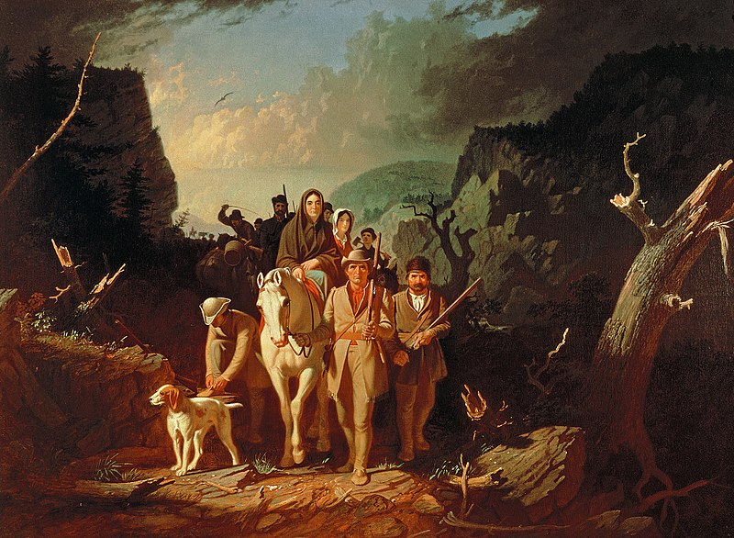
Boone Escorting Settlers Through Cumberland Pass

Slide 6
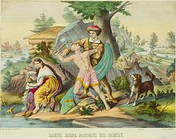
Boone Protecting his Family from “Injuns”

Slide 7
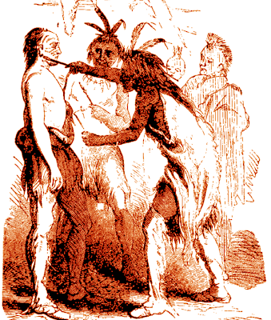
Boone being Adapted as a “Son” by the Victorious Shawanee Chief Blackfish

Slide 8
William Cody: Aka Buffalo Bill (born 1846, Iowa, U.S.—died 1917, Denver, Colorado
U.S Army Scout
Buffallo hunter
Indian Hunter
Showman
First global celebrity

Slide 9
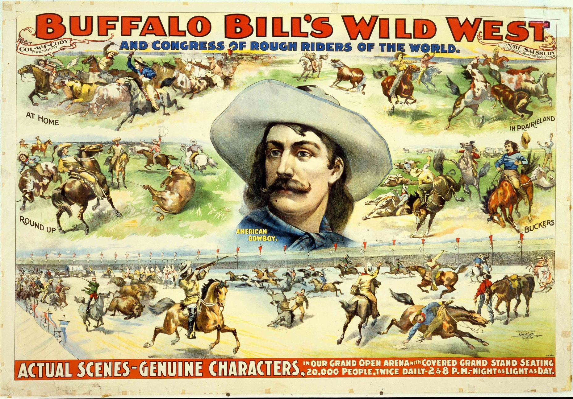
End of “real” Wild, Wild West-Beginning of the “Reel” Wild, Wild West

Slide 10
Dan Cody
A Composite Character
Violence & excitement of the WWW+ laissez faire capitalism of the 1800s (115, 117)

Slide 11
The Great J.D.R.
Another Self-made man
Oil Tycoon
Monopoly Capitalist
Ruthless Wheeler-Dealer
Old puppy-seller is J.D.R. look-alike (39)

Slide 12
The Train Timetable (chap. 4, pp. 74-77)
A metaphor for grey area between “old & clean money” and “new & stinky money”
Animal imagery
Names of old & “white & clean” moneyed people mixed up with “new and “dark” moneyed people
“decent” folks as well as “shady” ones

Slide 13
Clean vs. Unclean Money
Over the great bridge, with the sunlight through the girders making a constant flicker upon the moving cars, with the city rising up across the river in the white heaps and sugar lumps all built with a wish out of non-olfactory money. The City seen from the Queensboro Bridge is always the city seen for the first time, in its first wild promise of all the mystery and the beauty of the world.(82)

Slide 14
Meyer Wolfsheim
Based on Arnold Rothstein, (born 1882/83, New York City—died 1928, New York City),
American big-time gambler, bootlegger,
friend of high-placed politicians
masterminded Black Sox baseball scandal in 1919

Slide 15
Wolfsheim & Sportsmanship
Betting
Games of (fair?) chance
“Sporting” pages in pop. Newspapers
“be a sport” or some one being an “old sport” or a “good sport”
Actual sports men and women cheating

Slide 16
Difference between Wolfsheim-types and Rockefeller-types
Former: Recent immigrants, lower-class, & ethnic minorities
Driven by discrimination to life of crime
Latter:
Already privileged
getting richer & more powerful by unfair means

Slide 17
Is Nick Averse to “dirty” money?
Evidently not (98)!

Slide 18
Gatsby NYC Police Chief
shows “get out of jail for free” card while speeding (82)

Slide 19
Gatsby & Walter Chase
Chase-Manhattan Bank, great American financial establishment (150-151)
Even Tom’s friend Walter Chase received favors from Gatsby

Slide 20
Conclusions
Corruption at every level
New & old, clean & stinky totally mixed up
Fair means or foul makes no diff.

Slide 21
Nick and Gatsby Relationship
Just inter-class male friendship?
Or more than that?

Slide 22
Gay People in America in 1920s
Thriving Gay subculture in big cities
Pubs
Bars
Clubs
Broadway theater district
They had to be cautious, stay undercover
But generally tolerated
Things changed for worse During 1930s Great Depression

Slide 23
Fitzgerald and Co.
Fitzgerald's circle:
some closeted-Gay writers/artists
Some married to women as camouflage
own sexuality under scrutiny
Relationship with Hemingway: Bromance or romance?

Slide 24
Oleary’s arguments about The Great Gatsby
Nick as gay
Closeted from self and others
Uses women as denial-mechanism/camouflage
Chooses “masculine” women (my own expansion)
Finds macho Tom both attractive and repulsive

Slide 25
Oleary concluded
Finds Myrtle unattractive
Finds only Daisy’s voice attractive
Deeply Interested in fashion, appearance, etc
In “love” with Gatsby (throughout novel)
Mask “almost” drops in “bed scene” with McKee (chap. 2)

Slide 26
Nick: Not so Masculine
“Wild young men” tell him secrets at night in the bed room (11)
Daisy calls him a “a rose” (24) but Tom a “hulking specimen” (24)
Myrtle contrasts Wilson and him with Tom unfavorably (47-48)
In bedroom with “feminine” McKee (50)

Slide 27
Nick and Heterosexual relatioships and Mirroages.
Heterosexual marriages in general (only legal kind at this time) in bad light (65-66)
Particular ones too
Tom & Daisy
Wilson & Myrtle
Single state full of excitement but could lead to loneliness when you grow old because you know “fewer single men” (152)

Slide 28
But Nick likes Jordan, you say?
Yes but only as a camouflage
Running away from bondage of compulsory heterosexual relationships
Daisy wants him to date Jordan because both are restless and need to settle down (31-32)
Nick denies engagement with girl back home
Just “going out with old friend” (32)
Used that girl back home to avoid getting married?

Slide 29
Scenes with Jordan
Perhaps uses “flirtation” with Jordan as means to avoid commitment & his subconscious attraction to Gatsby
Often after a scene with Gatsby or with Gatsby & Daisy
Has first fight with Jordan after own 1st meeting with Gatsby (72-73)
Embraces Jordan 1st time after sacrificing Gatsby to Daisy (95)
Starts flirting with Jordan again as Gatsby & Daisy spend quality time (117)

Slide 30
With Gatsby
Gatsby’s smile (62)
Gatsby’s face and body in general (77) compare with Jordan's (23)
Slowly deepening bond with Gatsby
From mistrust to partial trust to sympathy (81, 94)
Helping a fellow romantic regain moment of perfection even though it can’t last (104, 107-108)
sounds pessimistic about Gatsby’s renewed love for Daisy and sounds critical (103, 108-109, 110, 112)

Slide 31
With Gatsby
From suspicion & censure to partisanship
Wants to clear “misconception” about Gatsby (117)
Defends Gatsby against Tom’s accusation (124)

Slide 32
With Gatsby Contd.
At end of chap 6 warns Gatsby (127)
Feels both sorry for and frustrated with Gatsby
Listens to his stories but mocks them while retelling them to us (127)
Just critical or also Jealous of Daisy? (127-128)
Disapproves of Daisy’s influence on Gatsby’s single-male establishment (130)

Slide 33
With Gatsby Concluded
Reports Daisy's treachery subtly
The shirts (108)
“the advertisement of the man” (135)
Overjoyed because Gatsby finally realizes truth about Daisy (136)
Vindicated again (145)
Yet again (160, 162)

